Slide 1
FOUNTAIN RESTORATION - BRINGING BACK THE IT PARK GLORY From Neglected Corner to Attractive Waiting Area
A Small Initiative, Big Impact - Improving Visitor Experience at Hubli IT Park

Slide 2
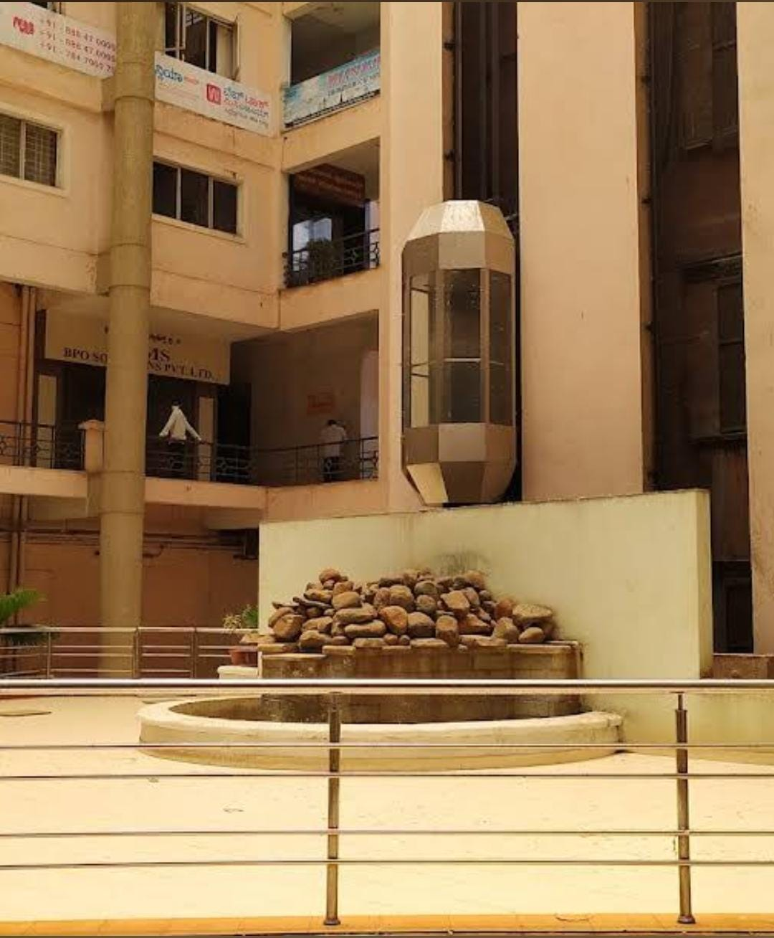
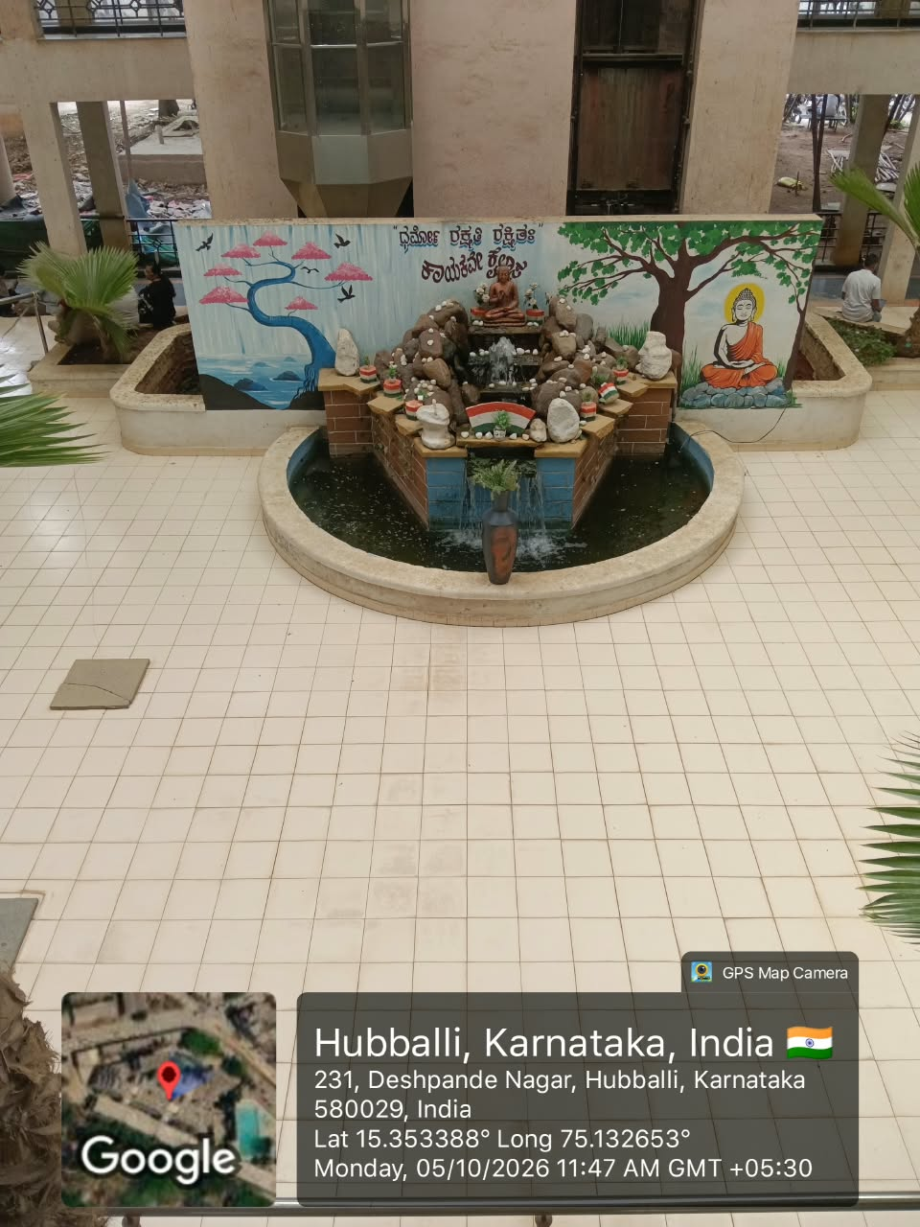
BEFORE: Non-Functional & Unattractive - IT Look Missing
AFTER: Fully Restored & Beautiful - Welcoming Ambience for Visitors

Slide 3
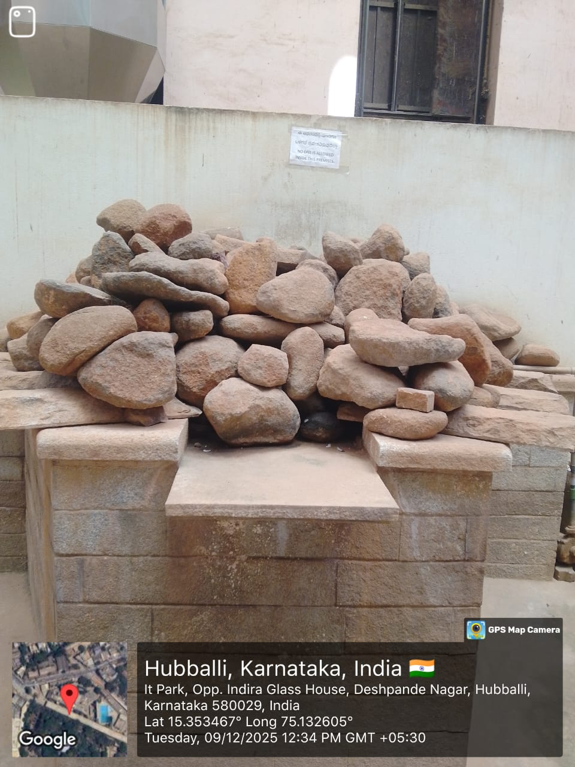
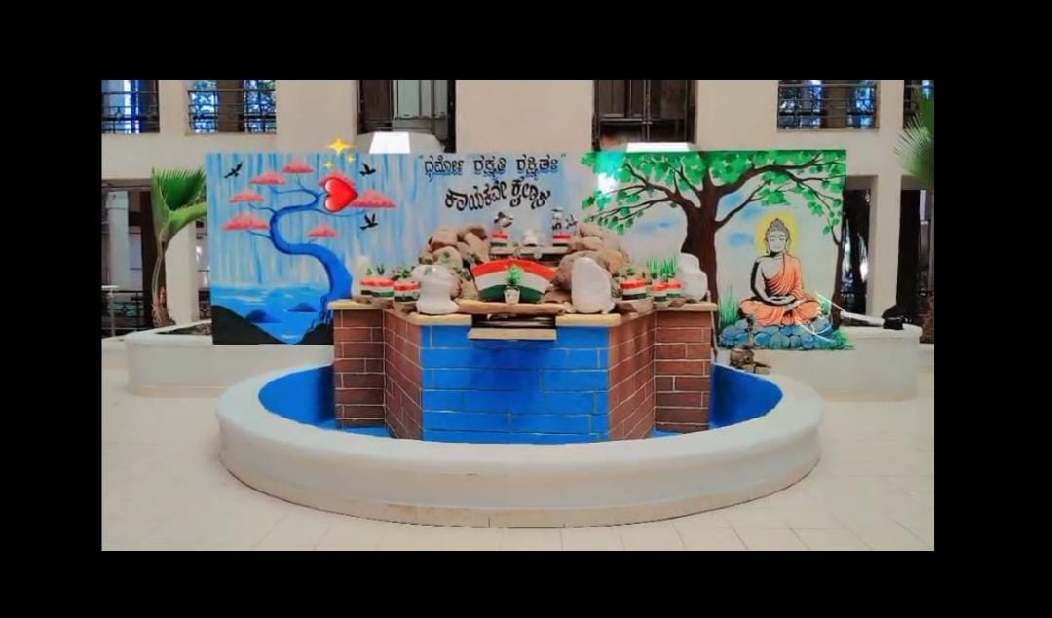
BEFORE & AFTER - FOUNTAIN MAKE OVER
From Dumped Stones to Beautiful Art Piece
BEFORE
AFTER

Slide 4
Observation:
Fountain was damaged and non-functional for a long time, giving a dull look to IT Park building.
Action Taken:
As suggested to Manager Vijay Dev Sir, Security & Housekeeping team jointly repaired and restored the fountain.
Impact:
Now Passport Office visitors waiting outside feel pleasant. Restored fountain enhances the IT Park image and provides a relaxing time-pass while waiting, instead of feeling bored.

Slide 5
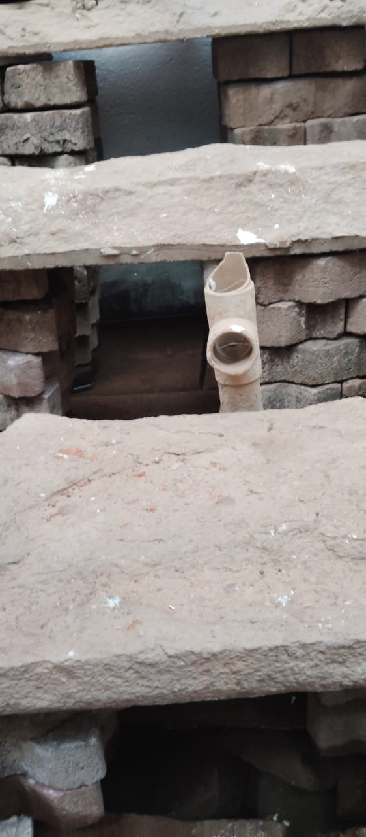
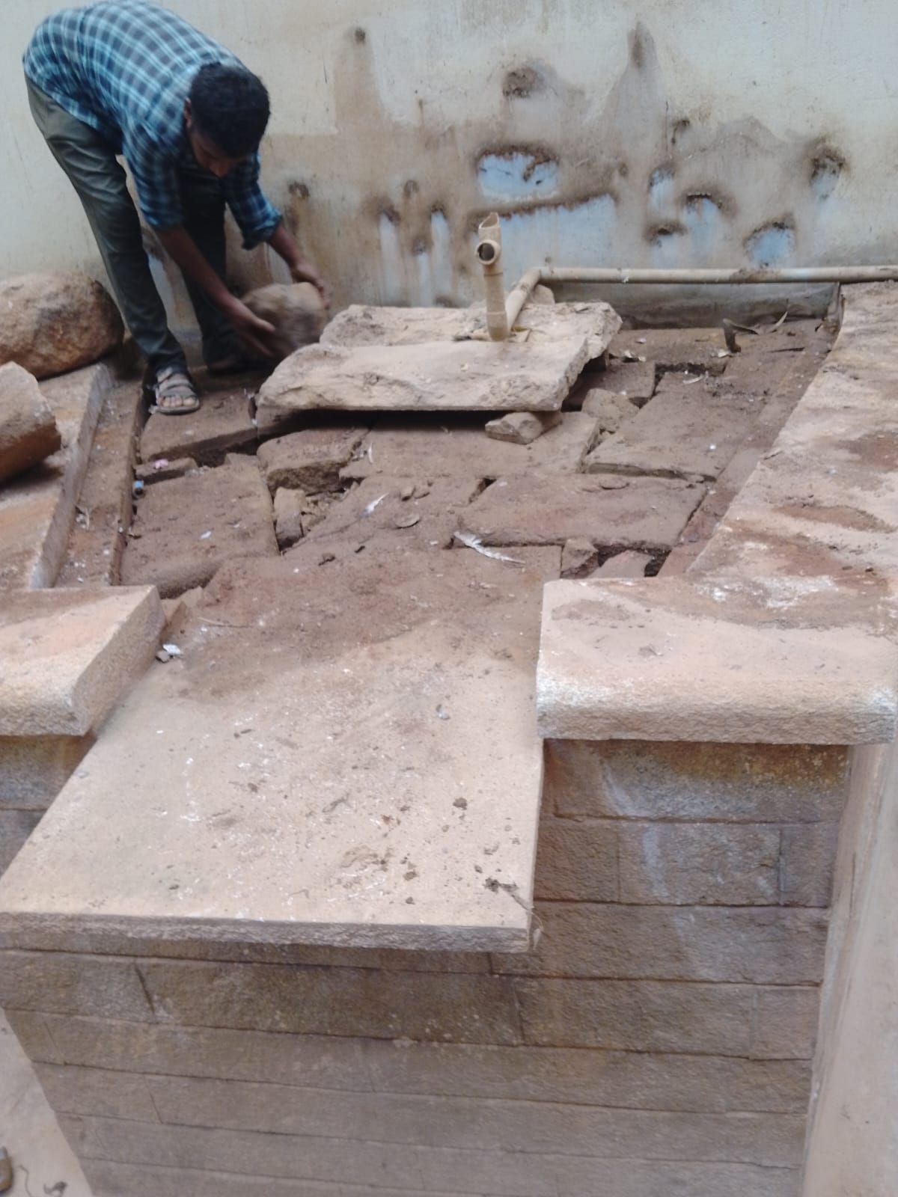
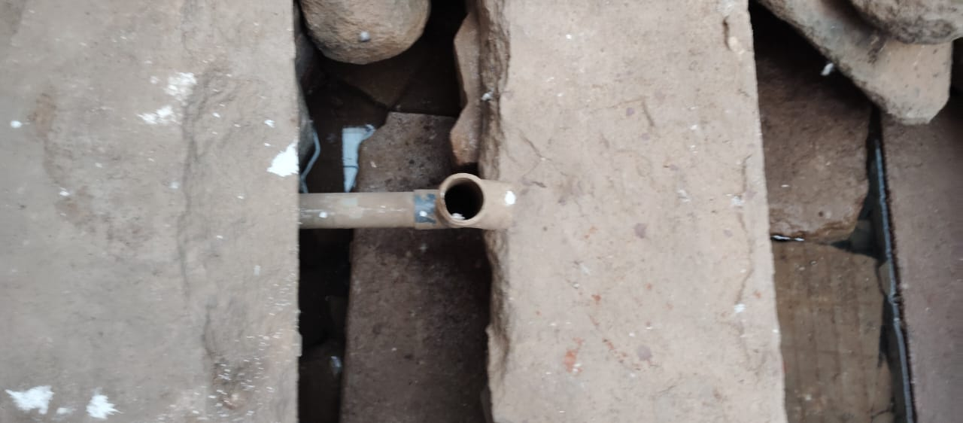
FOUNTAIN RESTORATION - WORK IN PROGRESS Dismantling, Cleaning & Systematic Re-arrangement of Stones
Cleaning & Re-arranging Stones by Staff
Removing All Dumped Stones from Fountain
Proper Setting for Water Flow System

Slide 6
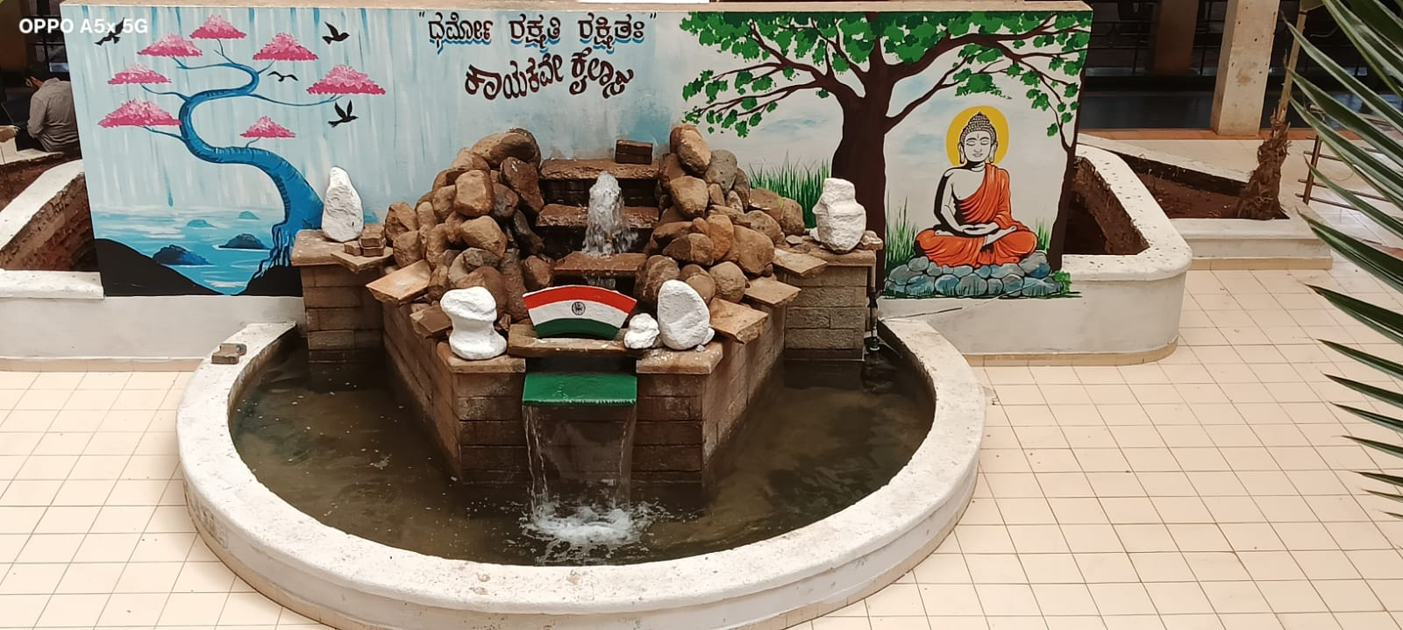
TEAMWORK BRINGS FOUNTAIN BACK TO LIFE Enthusiastic Efforts + Creative Support = Beautiful Result

Slide 7
Inspiration in Action:
Seeing the enthusiasm of our Security & Housekeeping team in restoring the fountain, our Electrical Head, Mr. Basavaraj Ganamuki, came forward voluntarily.
He engaged a wall painter and got the back wall beautifully painted with Buddha & Nature art, featuring the message "Dharmo Rakshati Rakshitah - Kayakave Kailasa" (Work is Worship).
Systematically arranged all fountain stones and successfully re-started the fountain.
Result:
A perfect example of Teamwork and Ownership at Hubli IT Park.
From Waste to Wonder - A Joint Effort of Security, Housekeeping & Electrical Team

Slide 8
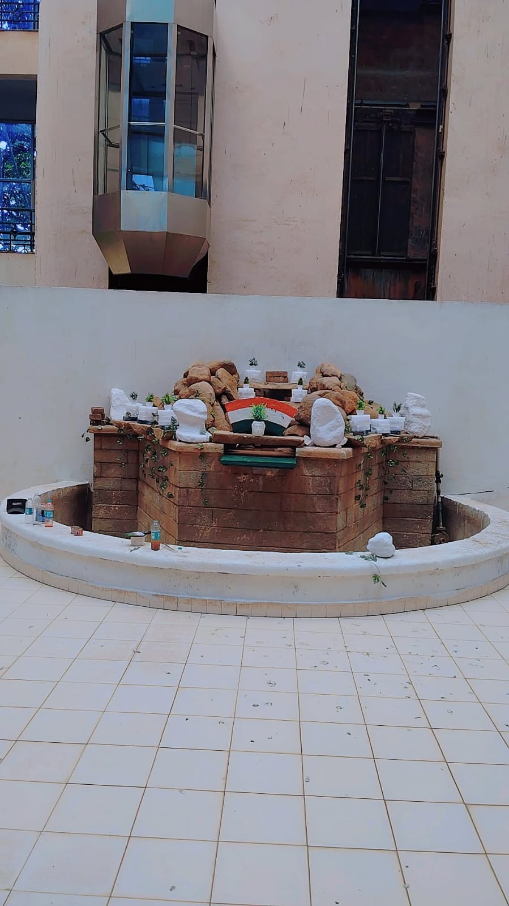
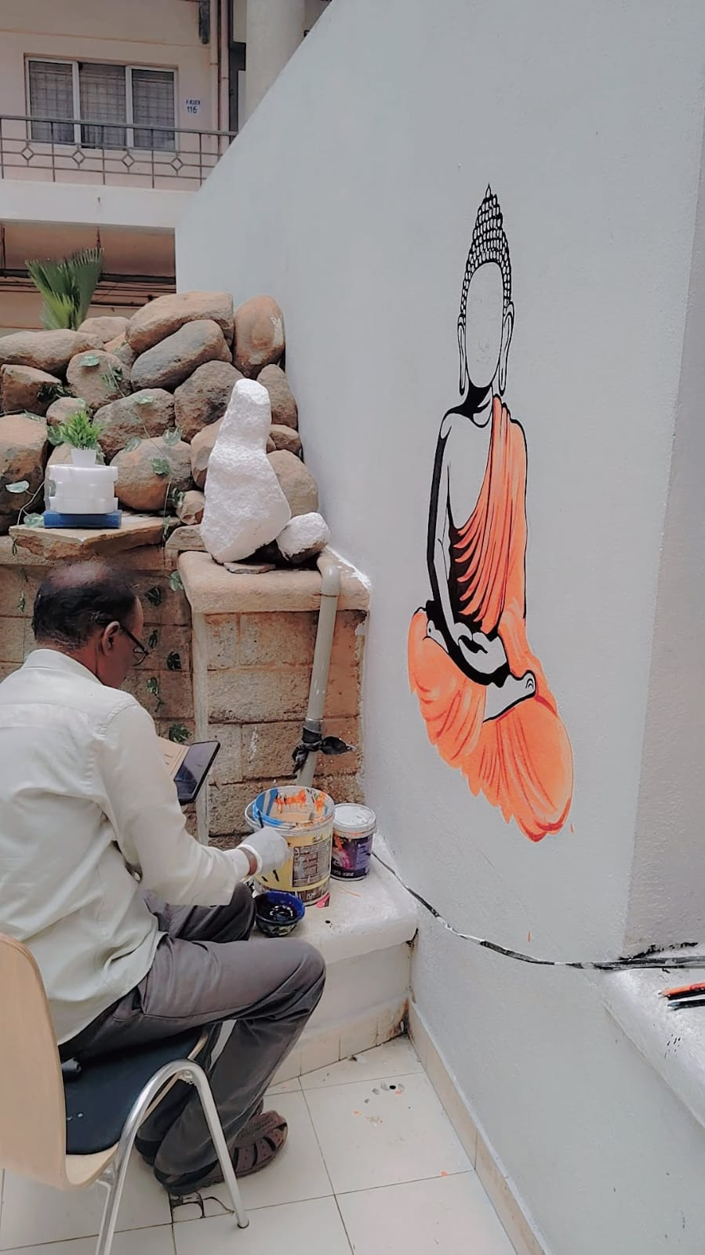
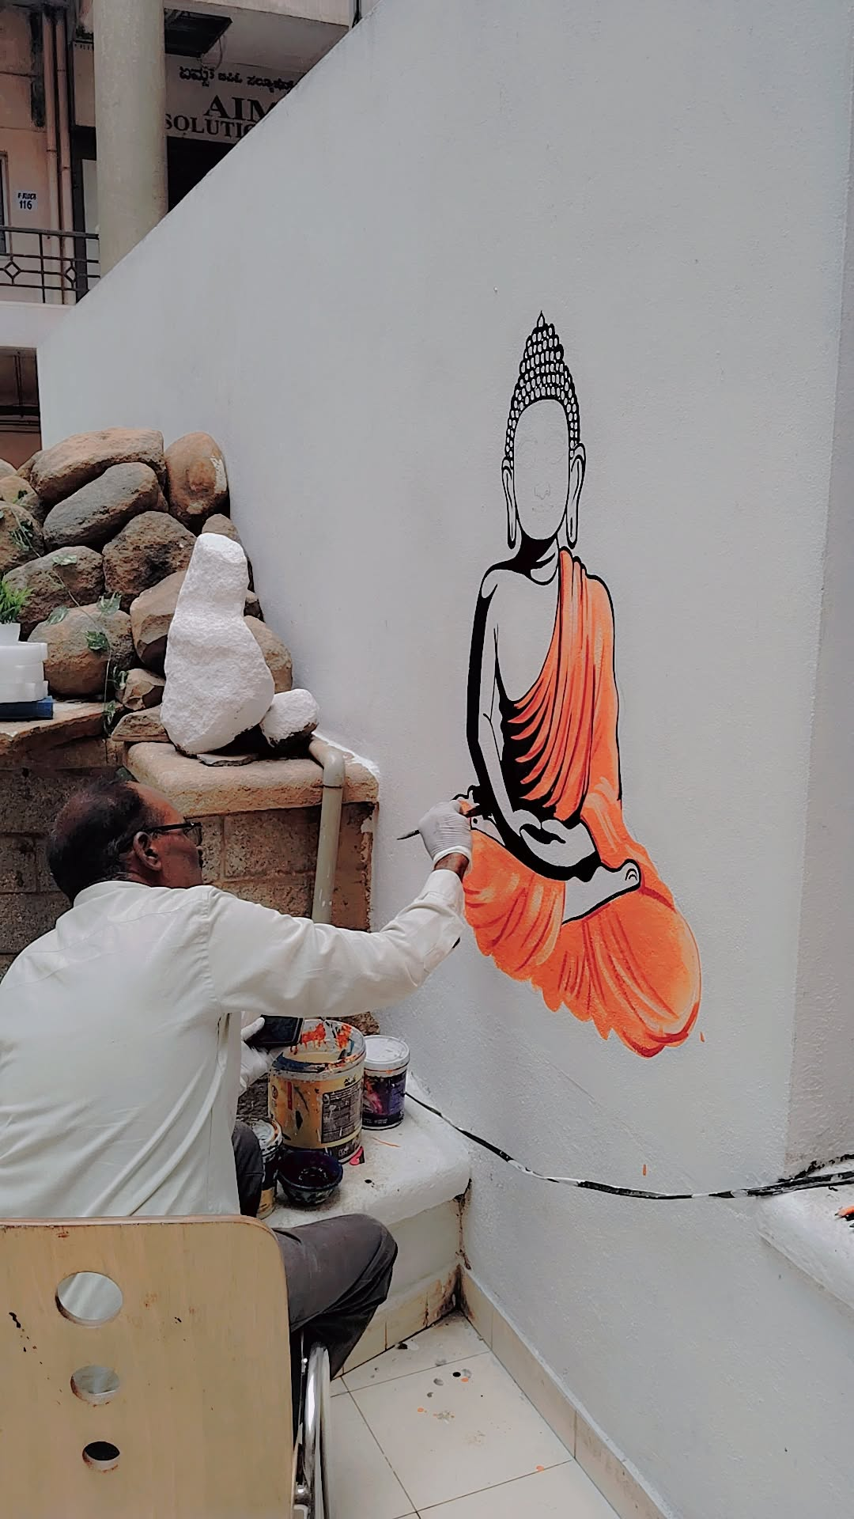
From Waste to Wonder: Artistic Transformation of Fountain Wall

Slide 9
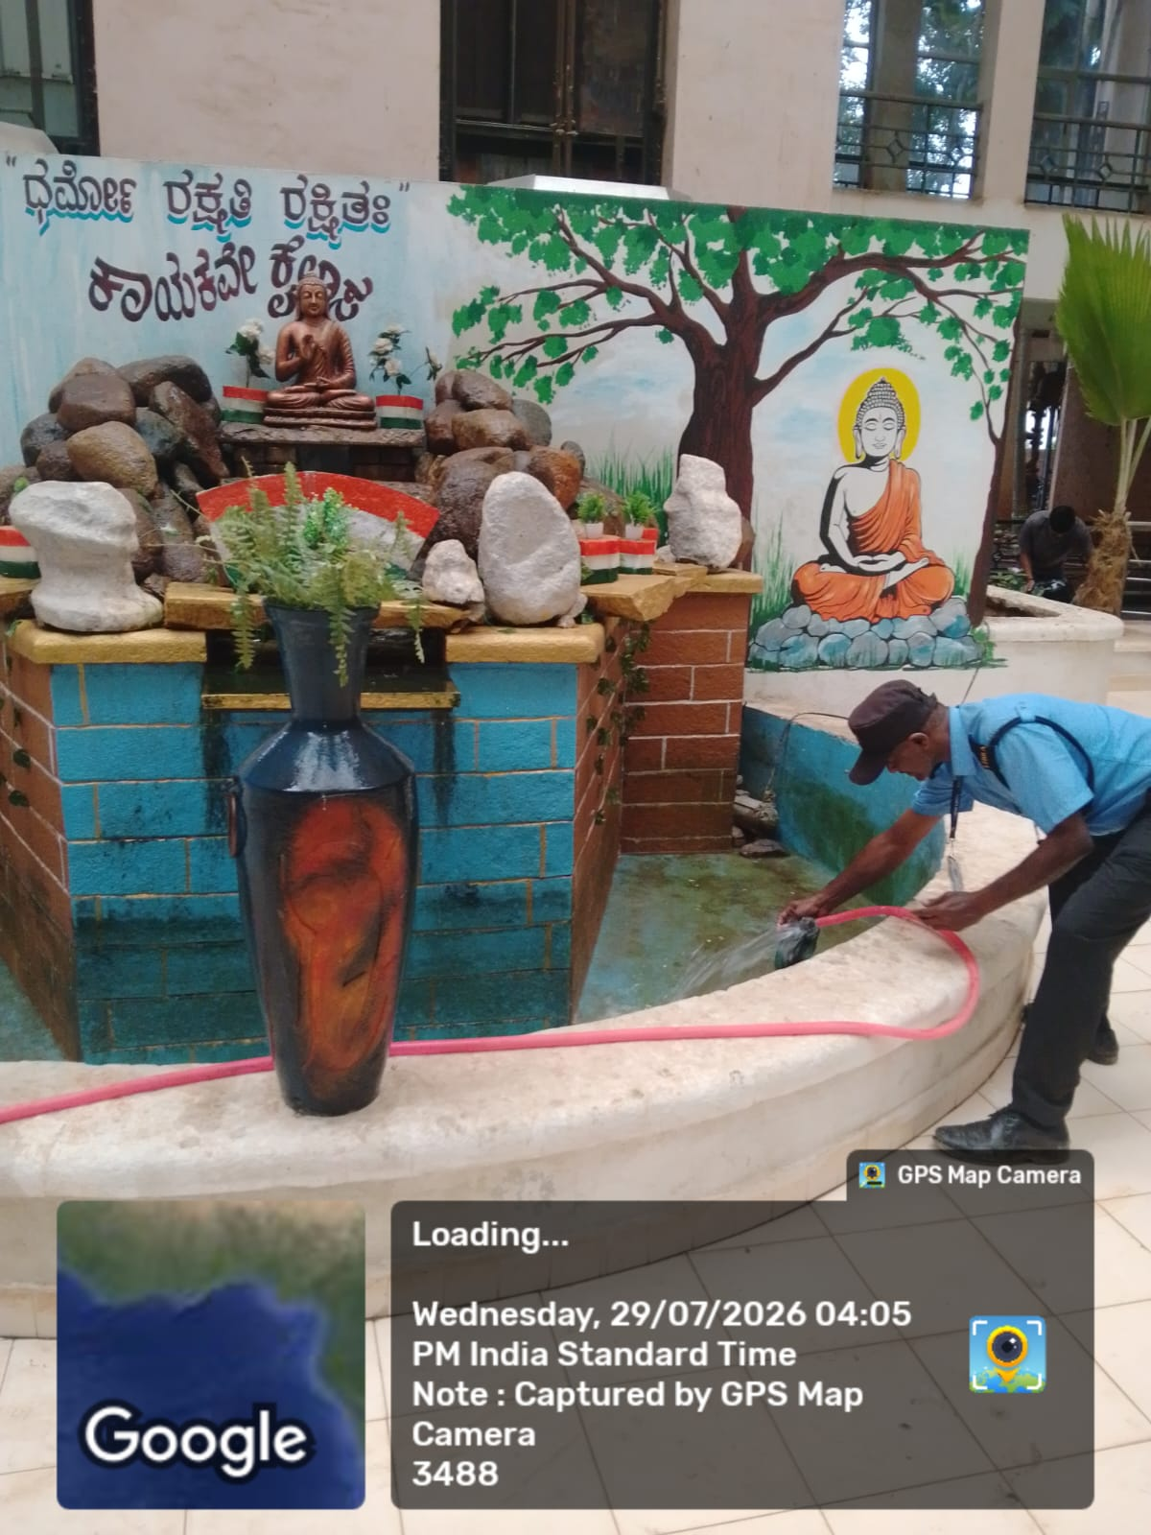
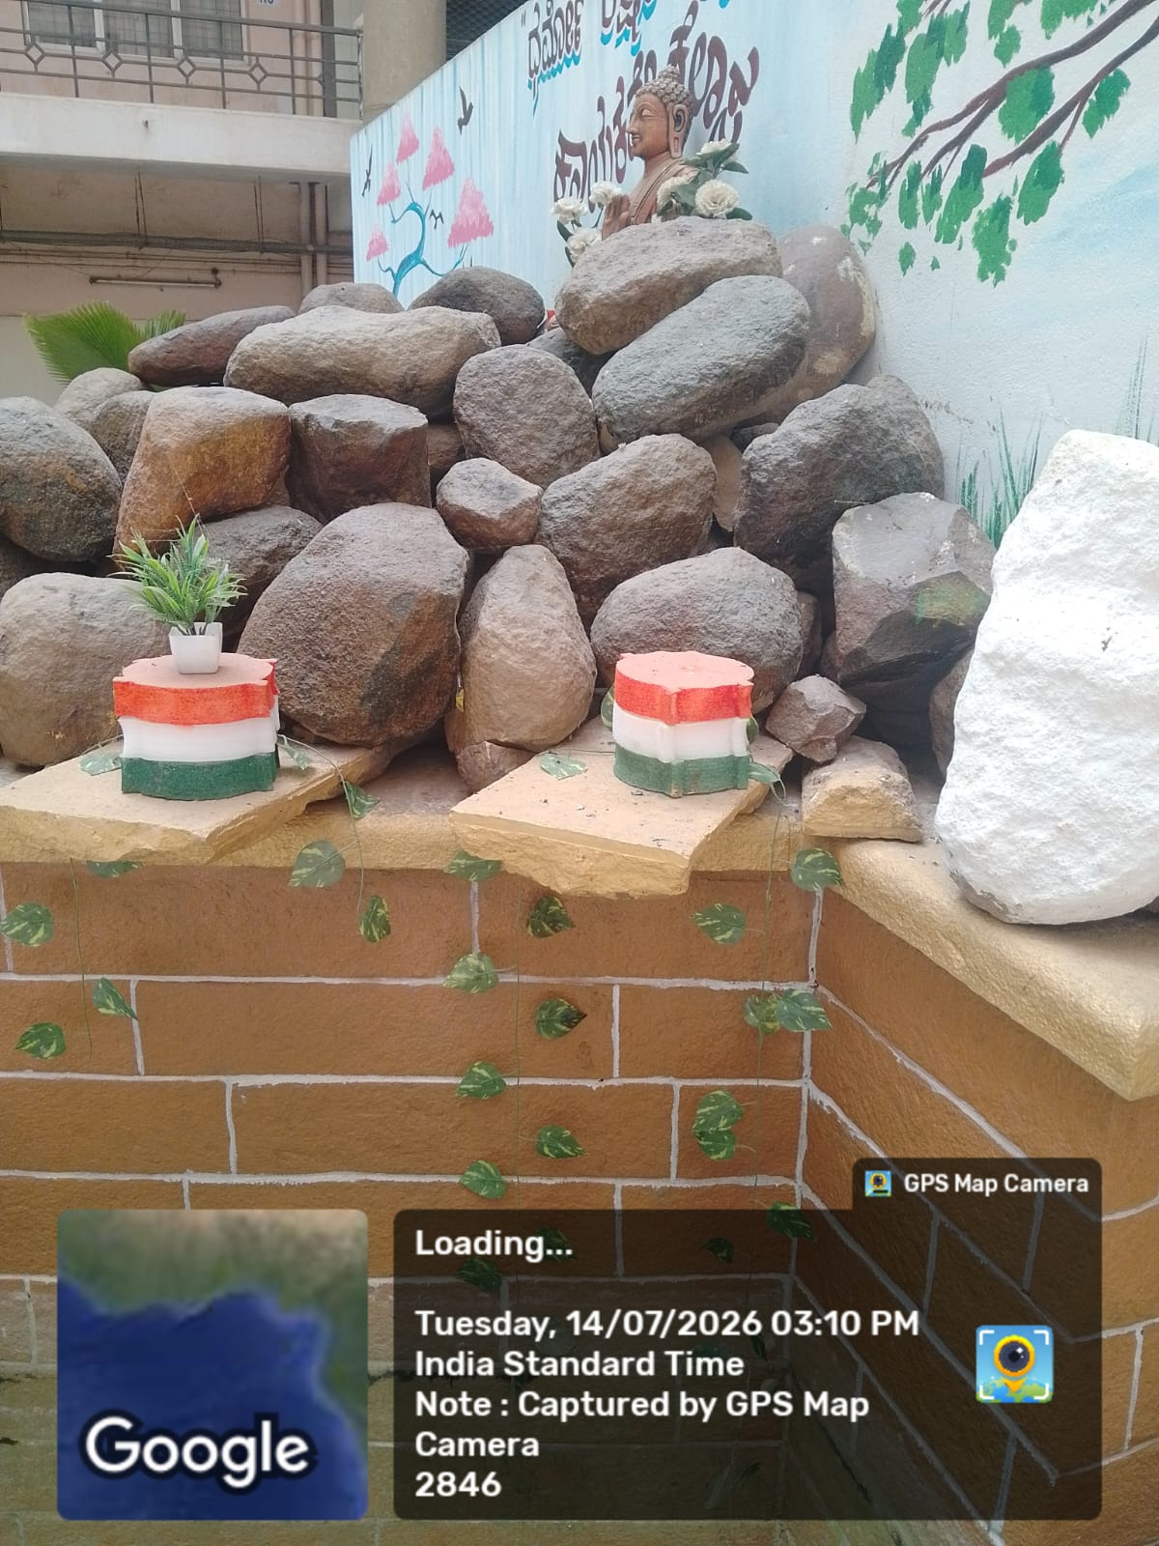
Own Team, Own Work: No external labour called. Our Security staff themselves took initiative, brought paint and beautifully painted the entire fountain structure in blue and brick red combination. This shows their dedication and ownership towards Hubli IT Park beautification. Cost Saving + Best Result.

Slide 10
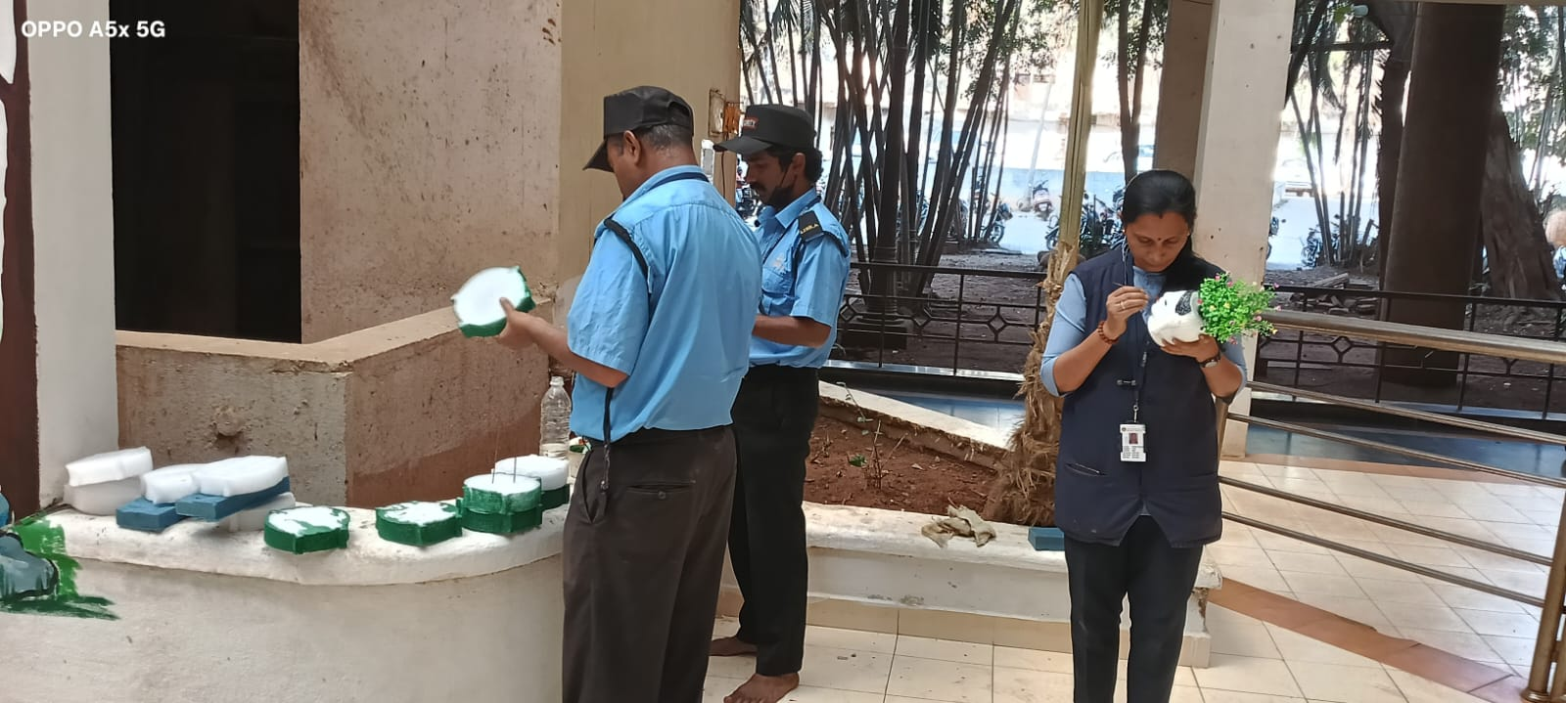
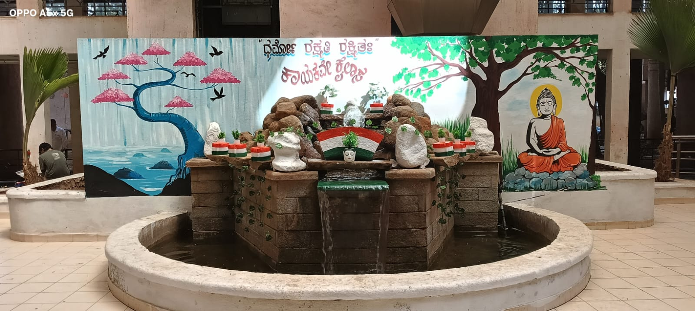
FINAL TOUCH - CREATIVE DECORATION Painting Small Pots & Items for Fountain Beautification
Preparation: Security Team Painting Decorative Pots in Tricolour Theme
Final Setup: Beautifully Decorated Fountain with Tricolour & Greenery

Slide 11
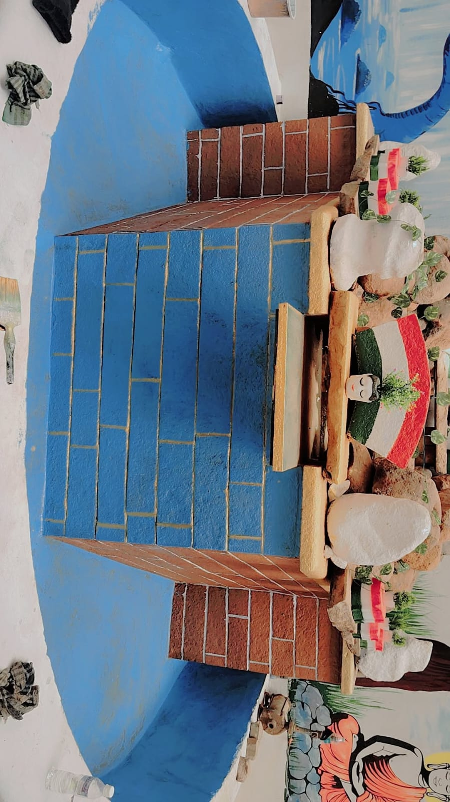
SECURITY TEAM'S ARTISTIC TOUCH
Fountain Painting Done by Our Security Staff
BEFORE: Unpainted Structure - Dull Appearance
AFTER: Painted by Security Team - Blue Theme with Brick Finish

Slide 12
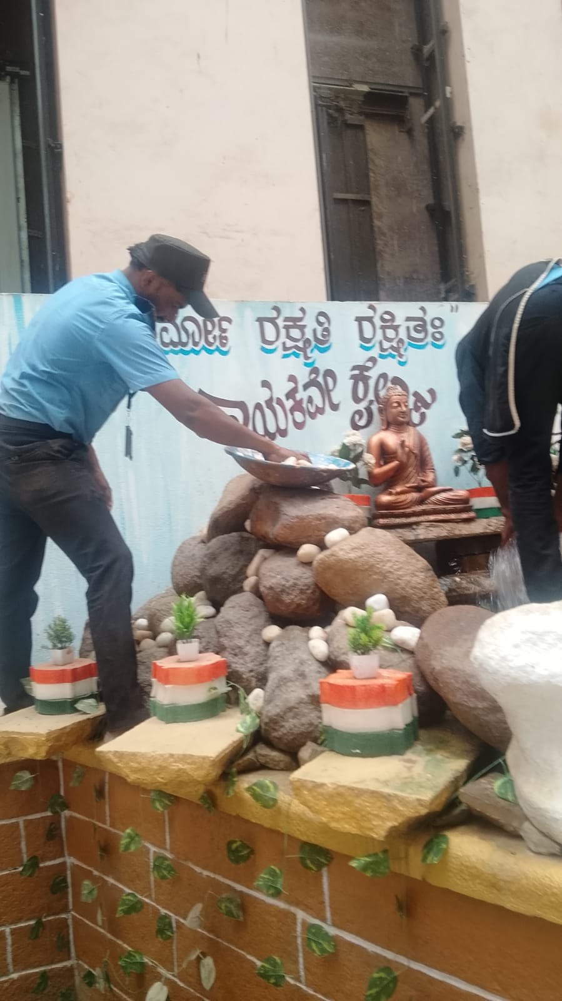
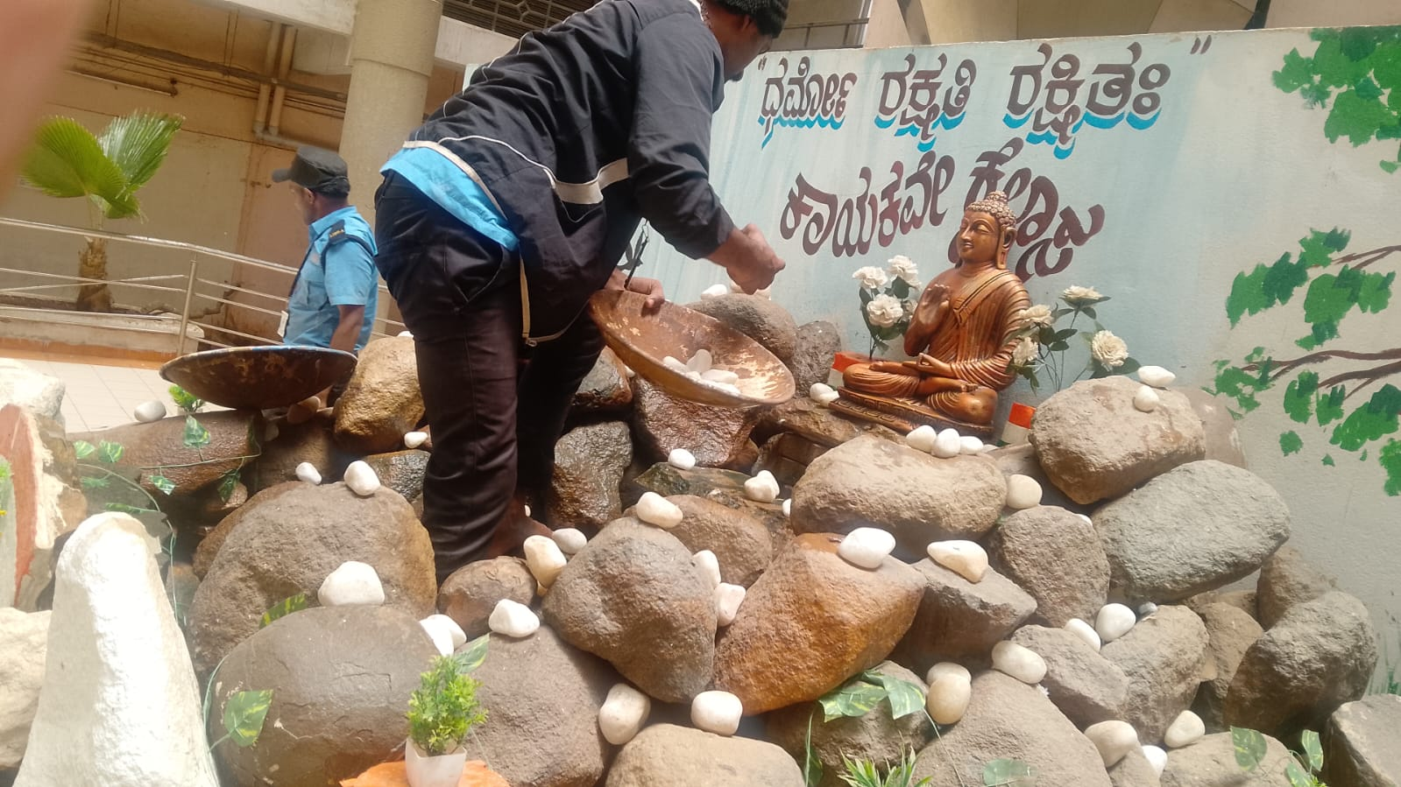
DIVINE TOUCH TO THE FOUNTAIN
Blessed with Buddha Statue by Manager Shri Vijay Dev Sir
Security Team Installing Buddha Statue & Decorating the Fountain with Devotion

Slide 13
Appreciation & Motivation:
Seeing our team's continuous dedication in developing the fountain, our Manager Shri Vijay Dev Sir appreciated the efforts and contributed a beautiful Buddha Statue for the IT Park Fountain.
Our Security staff installed the statue with great respect on top of the fountain rocks and decorated it beautifully with tricolour pots, plants and white pebbles, making it a Peace Corner.
This fountain now symbolizes Peace, Knowledge and Dharma –
"Dharmo Rakshati Rakshitah".
With Blessings from Management, Created with Devotion by Security Team

Slide 14
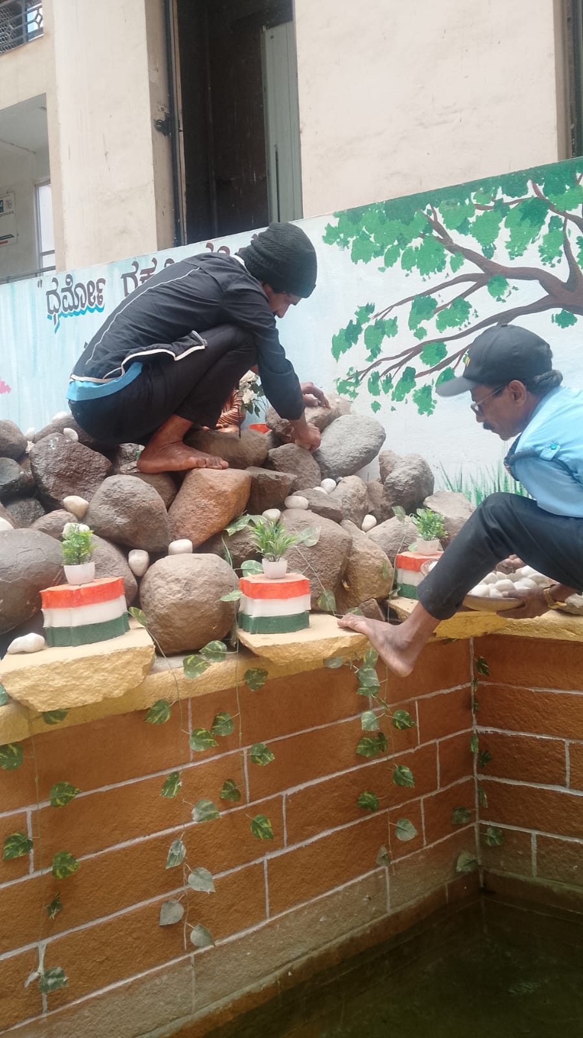
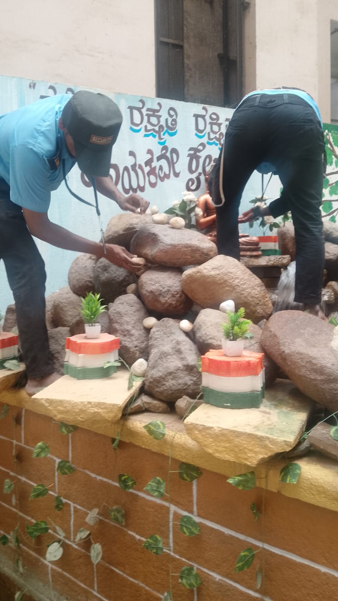
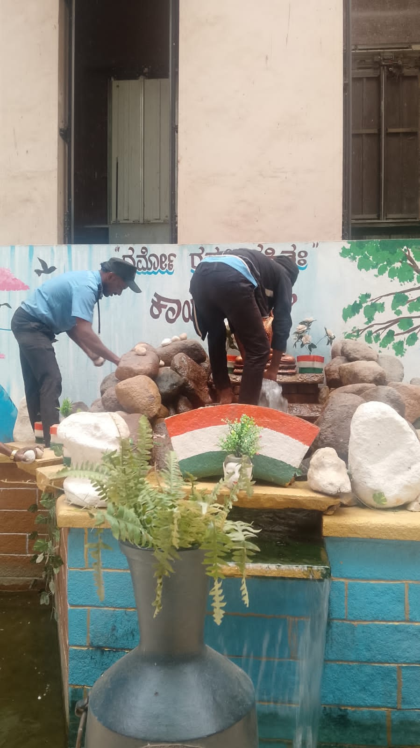
Attention to Detail: Our security team painted small decorative pots and stones in tricolored, added small green plants and arranged them aesthetically around the fountain. This final decoration made the fountain more lively, colourful and attractive for visitors.

Slide 15
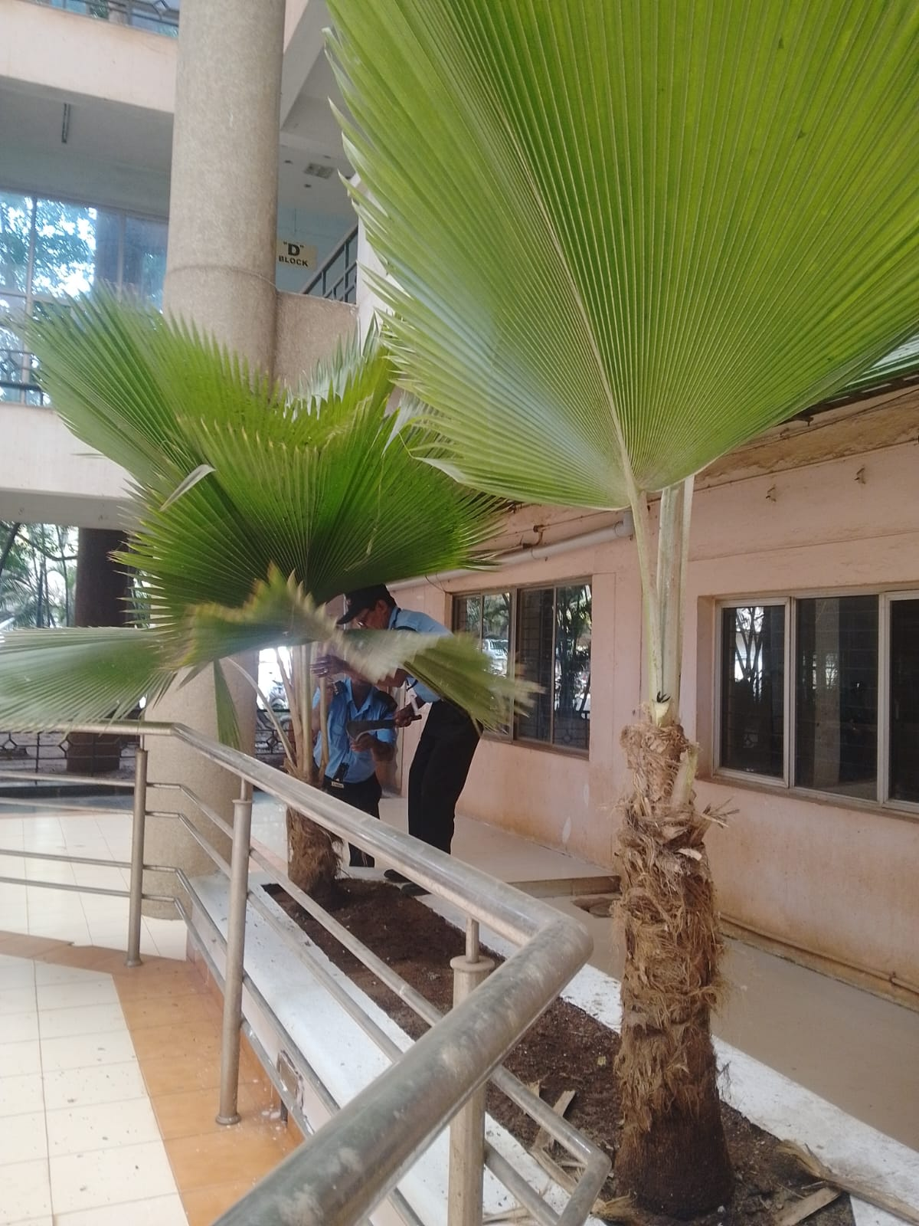
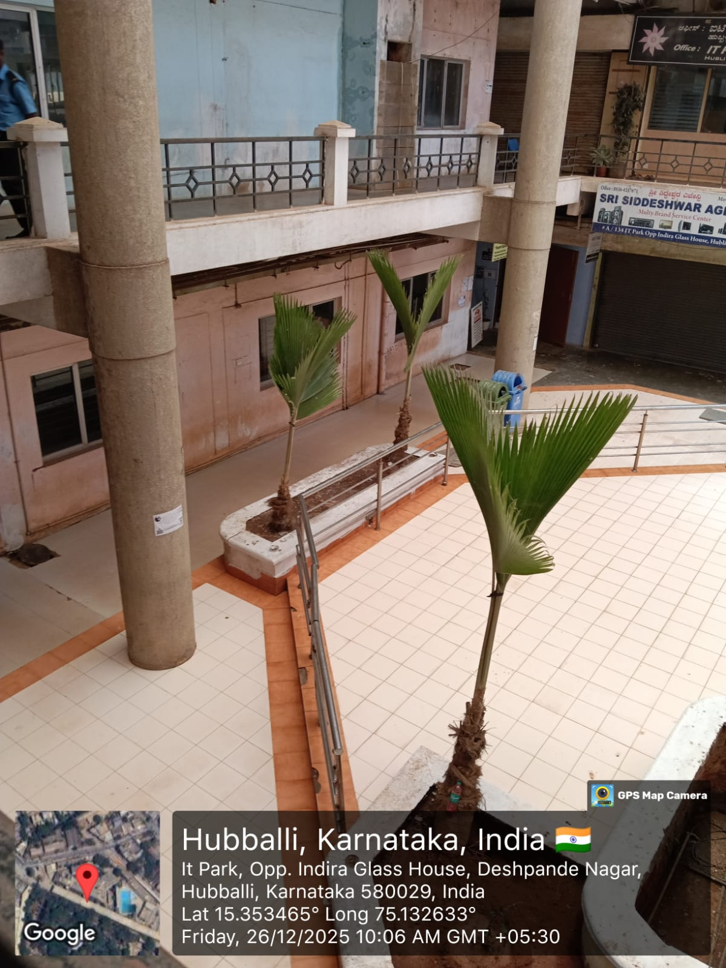
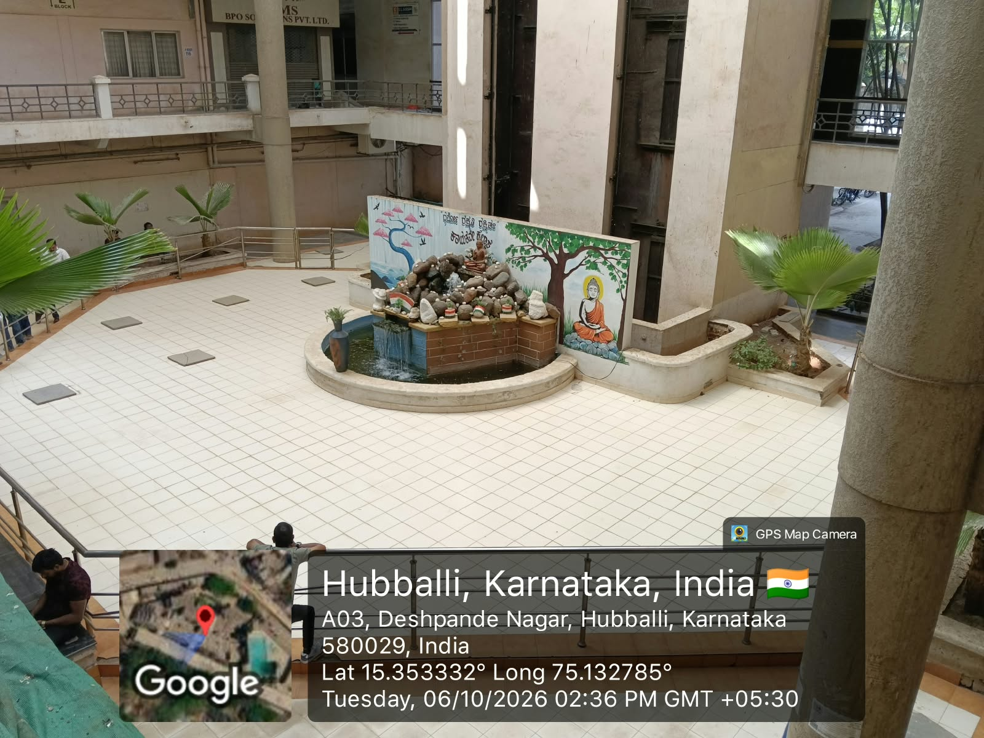
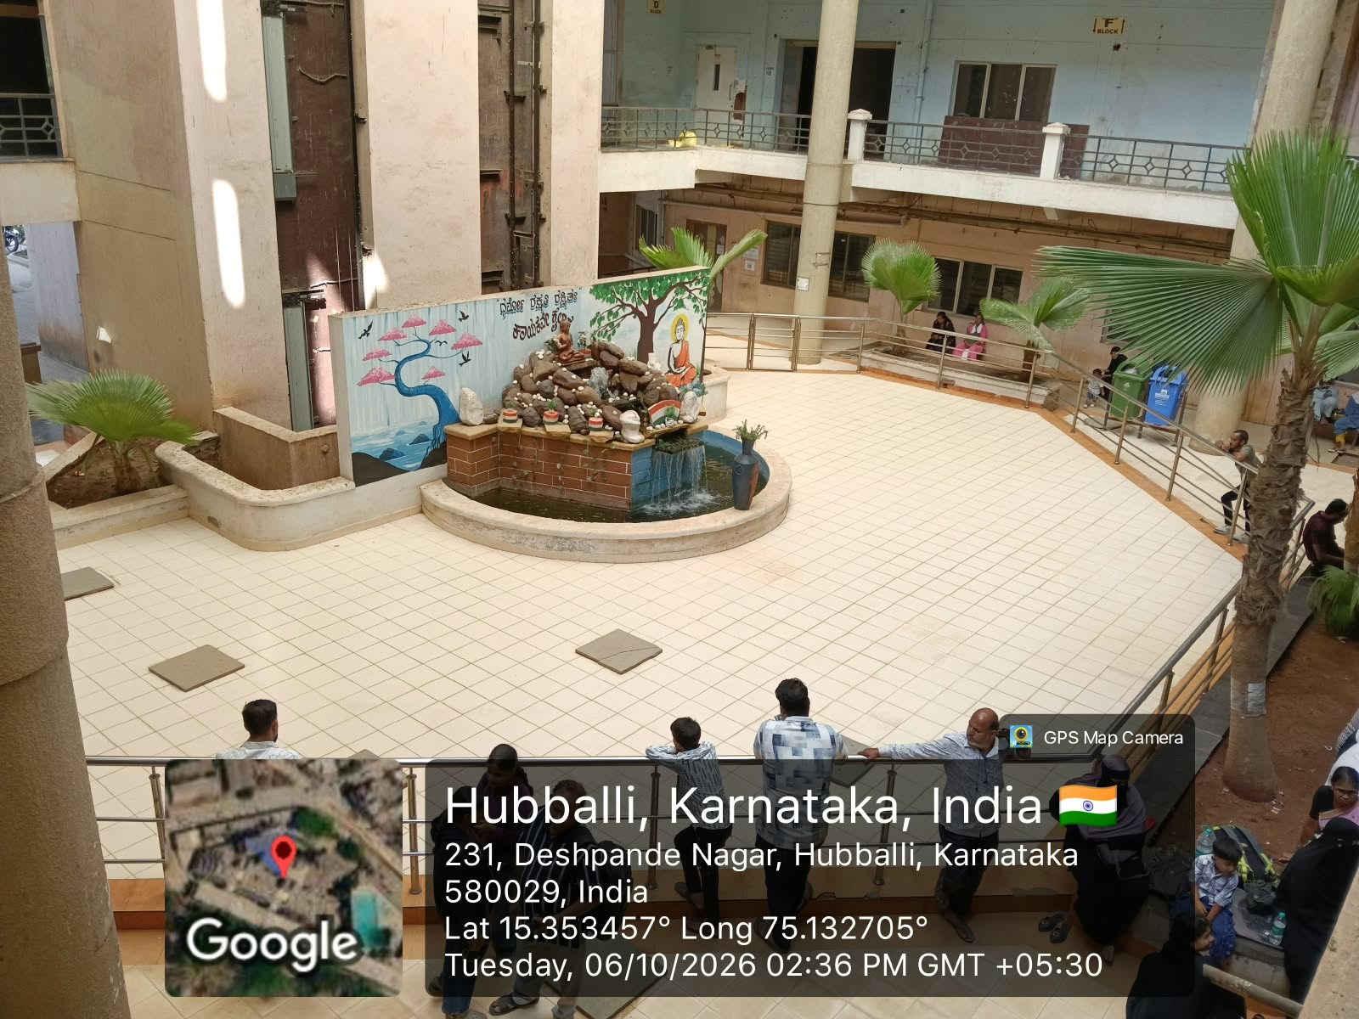
SURROUNDING AREA CLEANING & PLANT TRIMMING Ensuring Safety, Cleanliness & Clear CCTV View
Security Team Cleaning Unwanted Leaves & Trimming Plants Around Fountain Area

Slide 16
Safety & Greenery Maintenance:
Around the fountain, plants were overgrown and blocking the CCTV camera view and not growing properly. Our Security Team neatly trimmed the unwanted leaves, removed weeds, cleaned the entire surrounding area and made it neat and visible.
Benefit:
Now the area looks clean, plants will grow healthy, and CCTV coverage is 100% clear for security monitoring.
Clean Surroundings, Safe Premises, Clear Vision

Slide 17
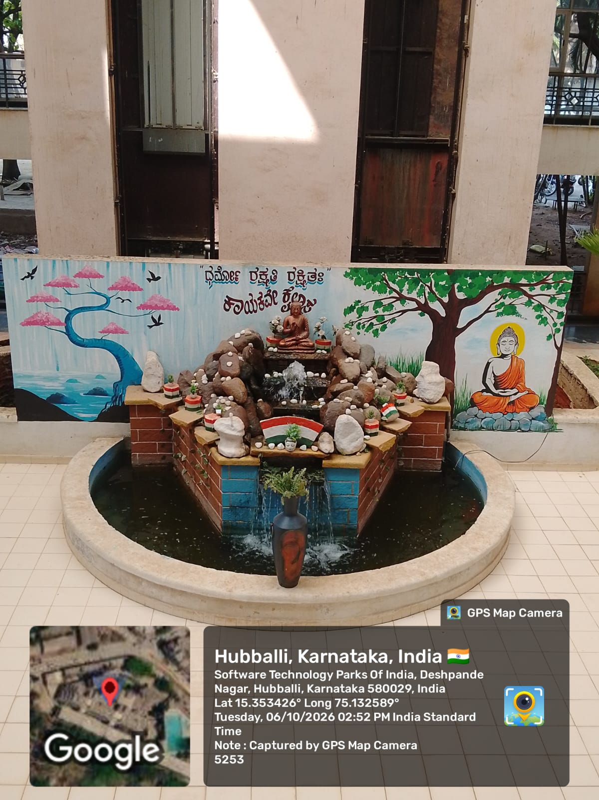
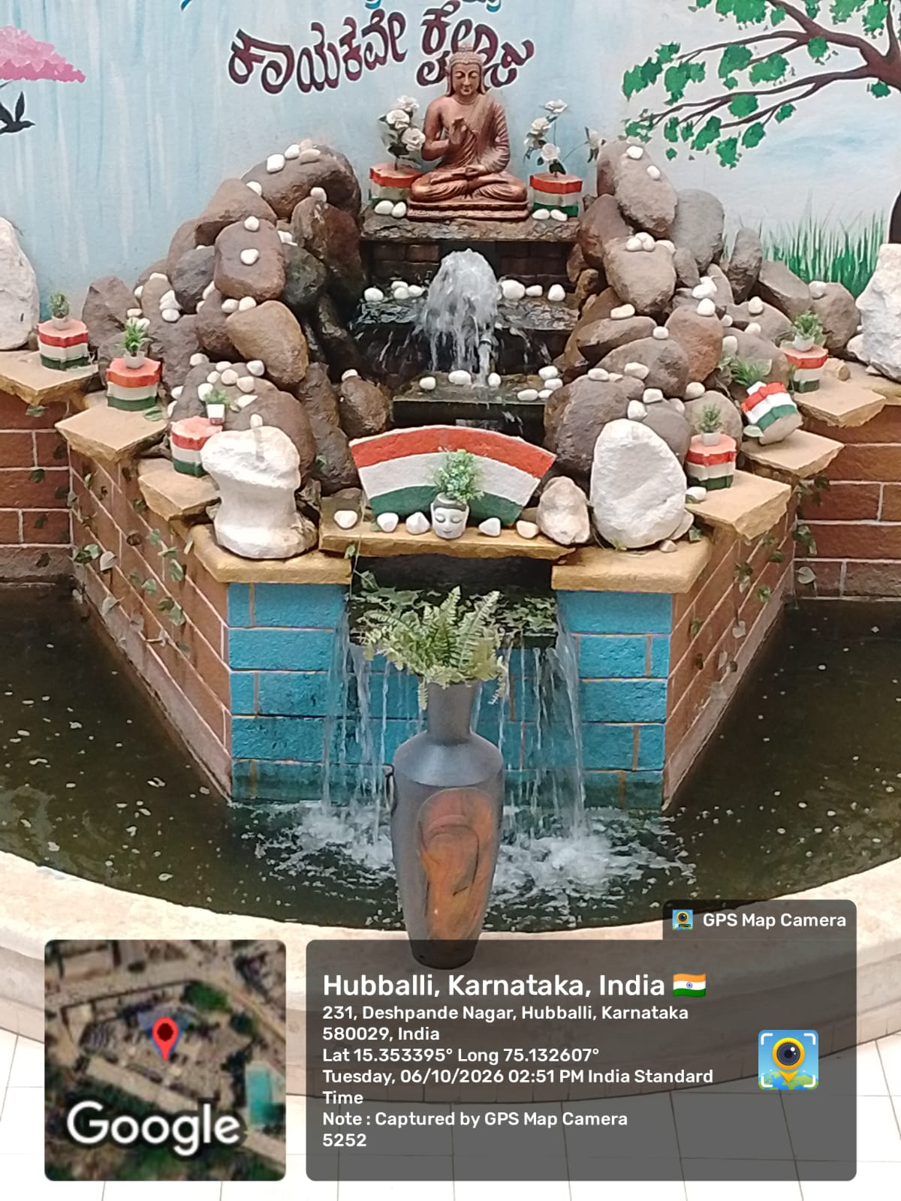
TRANSFORMATION COMPLETE - FROM DULL TO DIVINE Hubli IT Park Fountain - A Symbol of Teamwork & Dedication
FINAL OUTCOME: Peaceful Buddha Fountain with Tricolour Theme & Lush Greenery

Slide 18
From a neglected corner to the most peaceful and photogenic spot of IT Park - The entire beautification was done by our dedicated Security Team with blessings from Manager Shri Vijay Dev Sir.
With Blessings from Management, Created with Devotion by Security Team

Slide 19
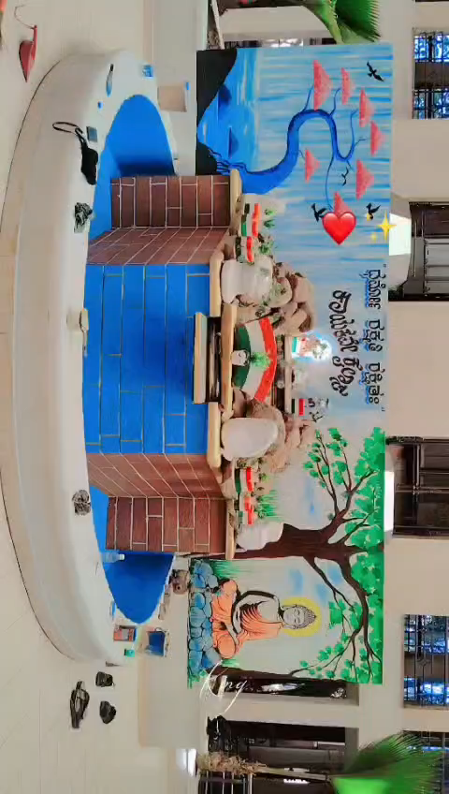

Fountain in Action - Video Presentation

Slide 20
THANK YOU FOR WATCHING

